Slide 1
Analysis of Covid-19 Impact on US Rental Market
RBDA-Fall, 2021
Ethan Bai Wanting Xi XueZhou Wen

Slide 2
Project Motivation & Objective
Motivation
US has the most covid-19 infections in the world
Majority of US workforce is working remotely impacting rental market
Schools and colleges conduct hybrid teaching mode sending millions of students home
Objective
Figure out how much covid-19 has impacted US rental market
Predict FY 2022 US rental prices and trends

Slide 3
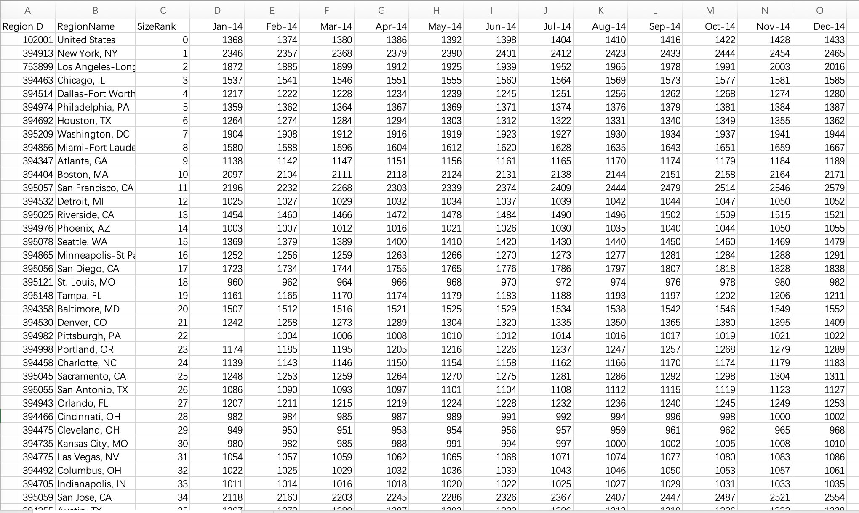
Data Source
Name:
Zillow Dataset
https://www.zillow.com/research/data/
Description:
Monthly rental price information by city across the US from 2014 to 2020.

Slide 4
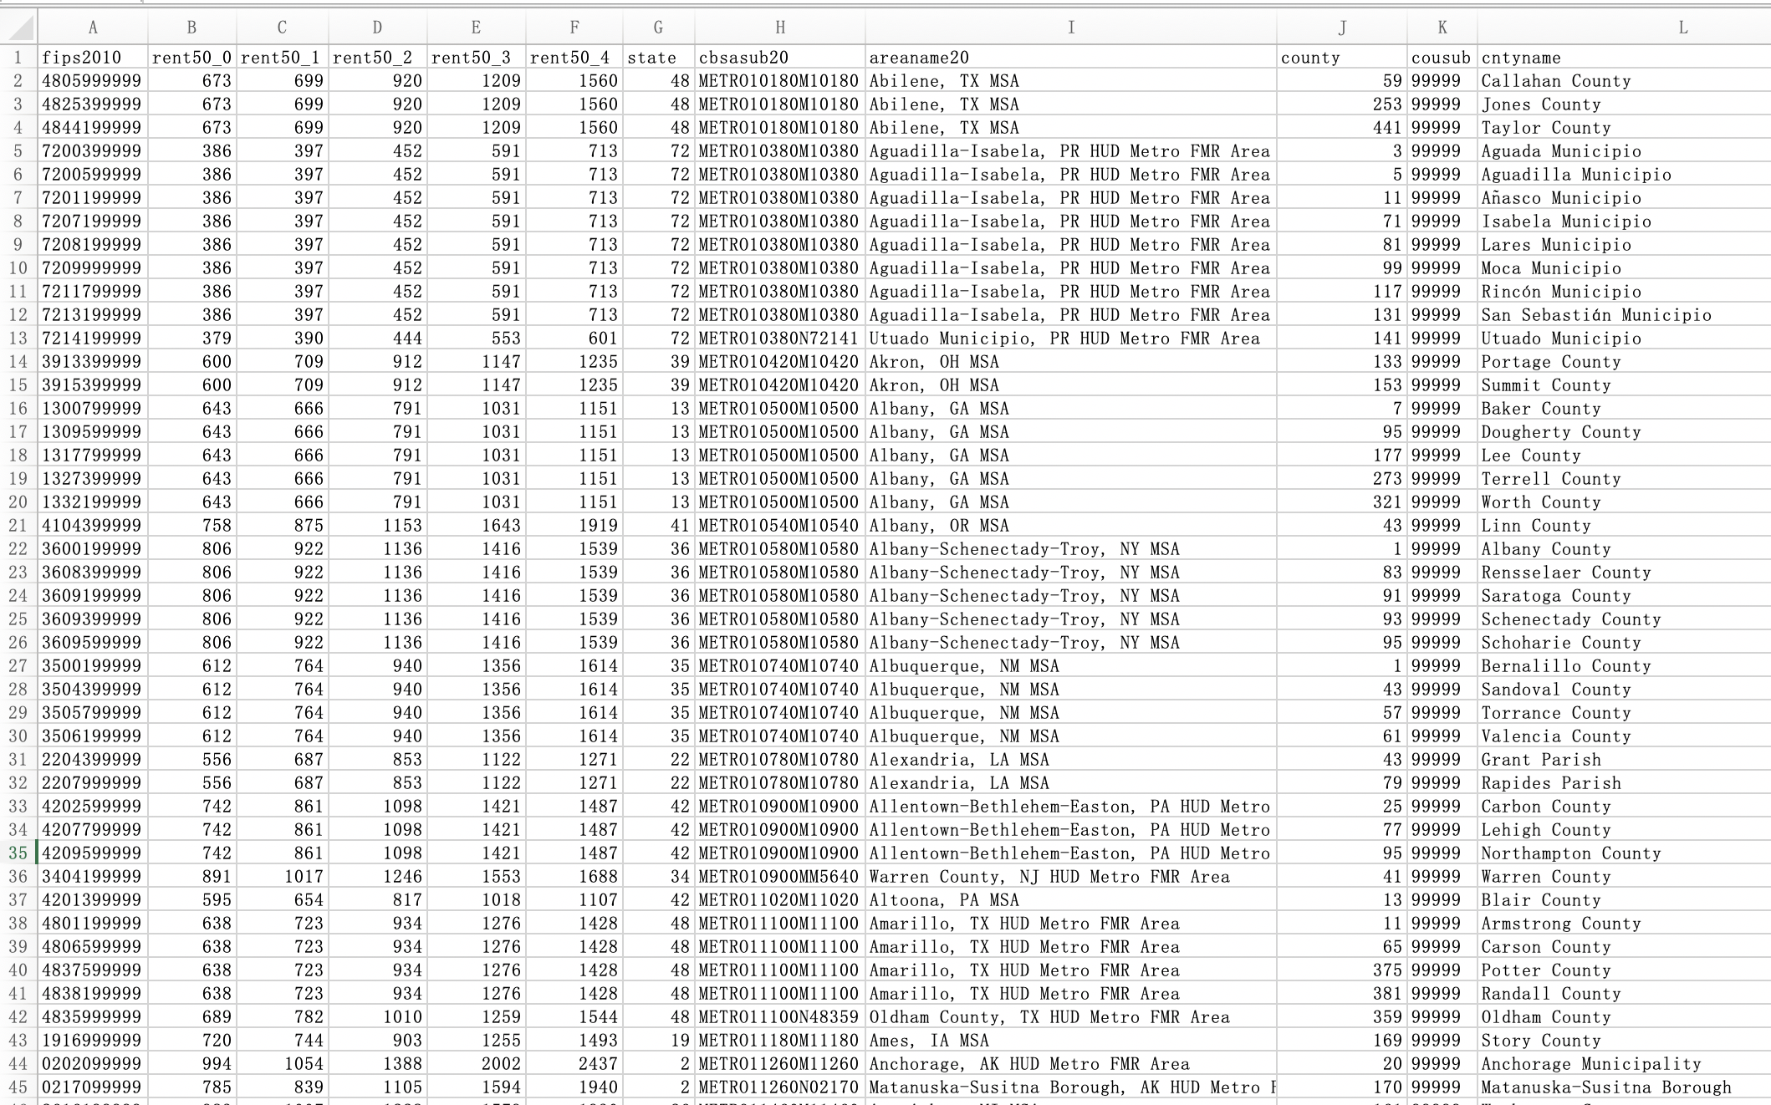
Data Source
Name:
Huduser.gov
https://www.huduser.gov/portal/datasets/50per.html#2020
Description:
5 years’ rent estimate at the 50th percentile by county

Slide 5
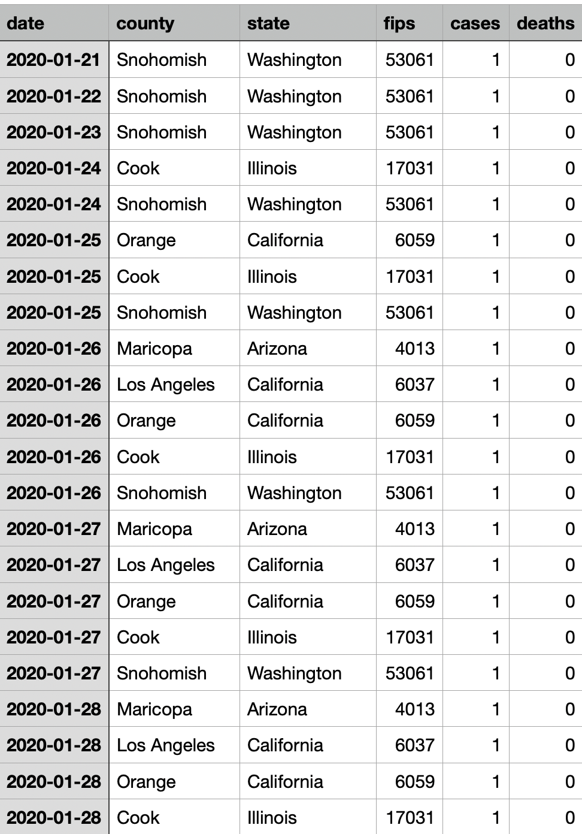
Data Source
Name:
Covid-19 dataset
https://github.com/nytimes/covid-19-data
Description:
Number of Covid-19 cases daliy by counties

Slide 6
Zillow Rental Data Research
Data structure:
Demographic: Zipcode, City, State
Data: Jan. 2014 - Oct. 2020 monthly rental prices
Methodologies:
Narrow down data to top 10 states with the most covid-19 infections
Normalize data on city level (e.g. combining all NYC zip code under NYC)
Compare year 2020 monthly price changes with 2019 rental data
Filter cities experiencing rental decreases
Visualization
Technical
Apache Pig
Tableau

Slide 7
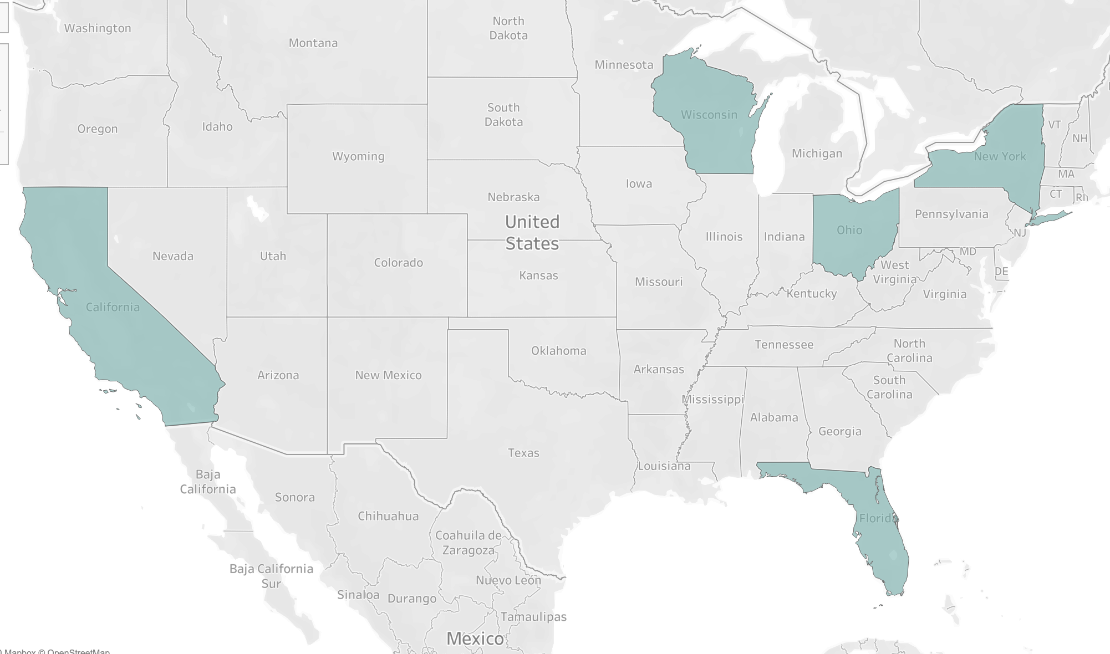
Zillow Analytics Results - 01
States firstly reporting covid-19 clusters experiencing rental price drops (e.g. CA, NY)
States with high covid-19 infection doesn’t imply rent decreases (e.g. IL)
States: NY, CA, WI, OH, FL

Slide 8
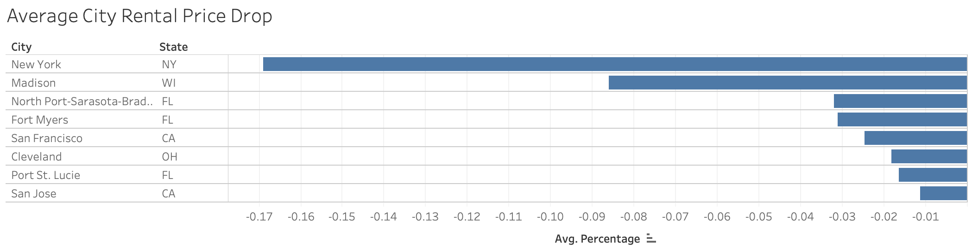
Zillow Analytics Results - 02
New York City has an average of 17% rental price decrease in 2020
City of Madison experienced 9% of rental price drop largely due to UW-Madison sending students and faculties home
The rest of the cities experience less than 3% rental price decreases

Slide 9
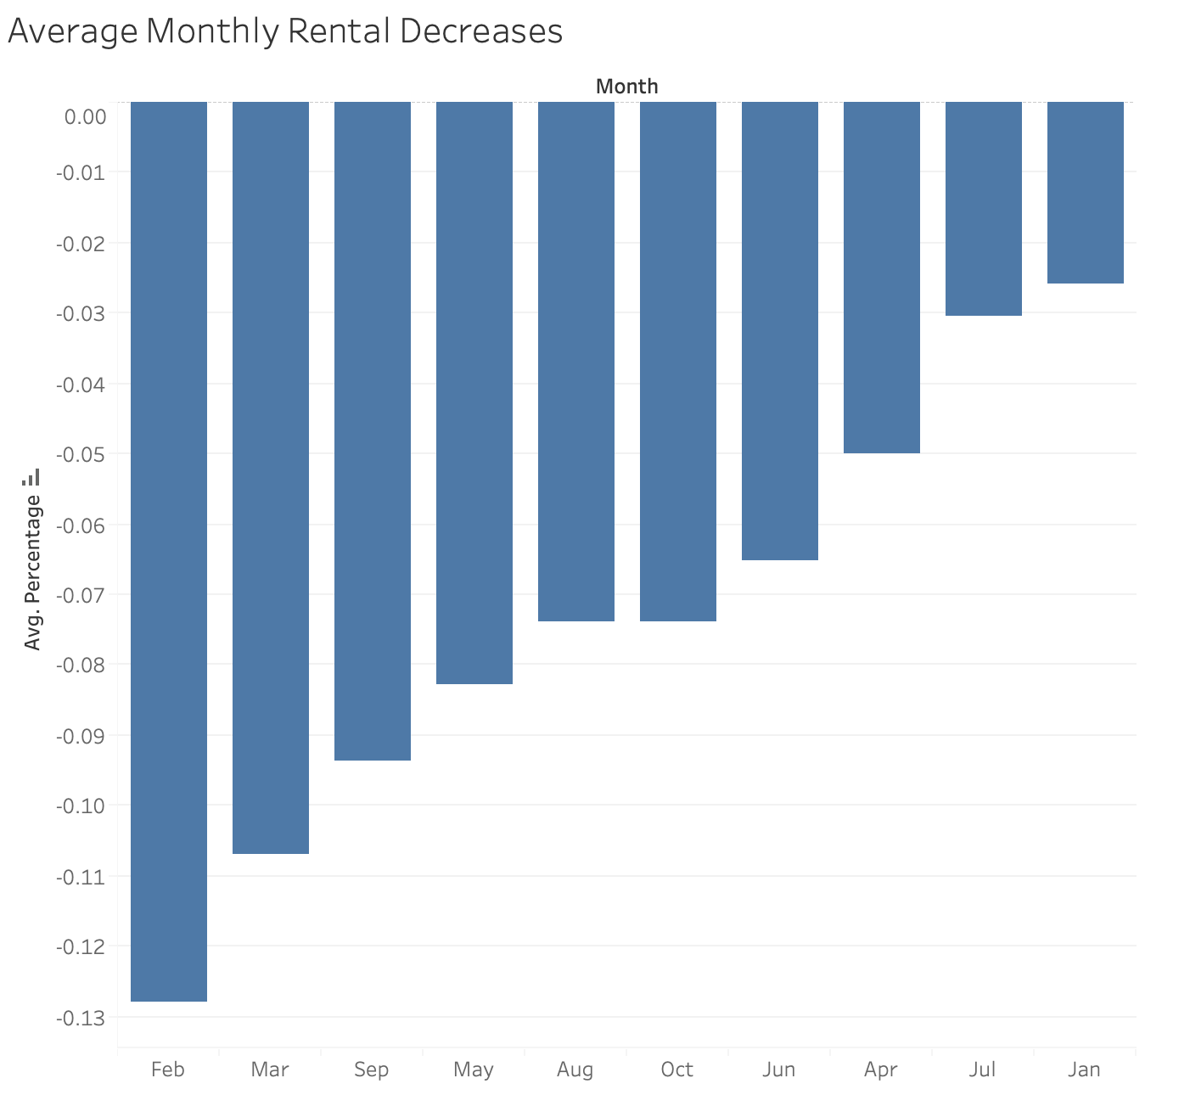
Zillow Analytics Results - 03
Month of February had the largest price drop of 13% due to covid-19 cases surging in the US
With covid-19 spreading across the US, people are staying home and rental prices didn’t decrease on Feb. scale, instead, the decrease narrows down.

Slide 10
Covid-19 & County Rent
Statistical Relationship:
Statistical relationship between Covid-19 infection number and the 50 percentile FMR of each county
Negatively affected
1244 counties rent with 0 bedrooms goes down
1281 counties rent with 1 bedrooms goes down …
About ⅓ number of counties’ rent goes down

Slide 11
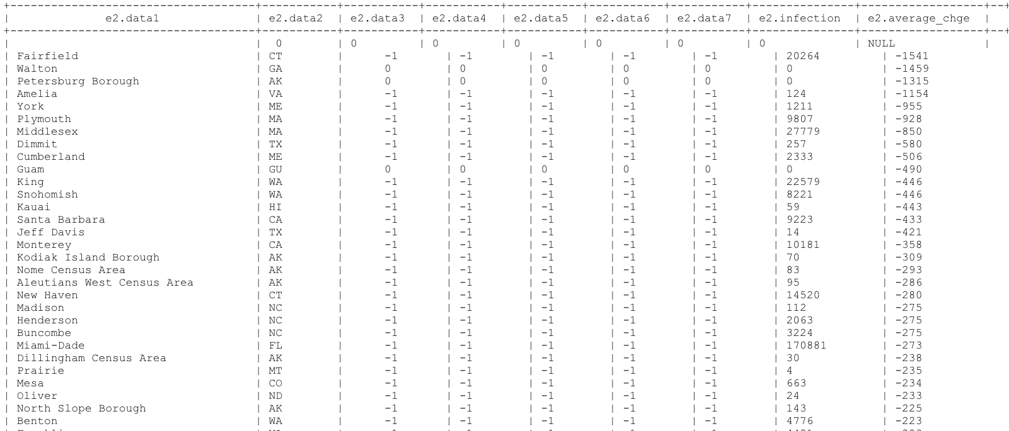
Counties with rent affected

Slide 12
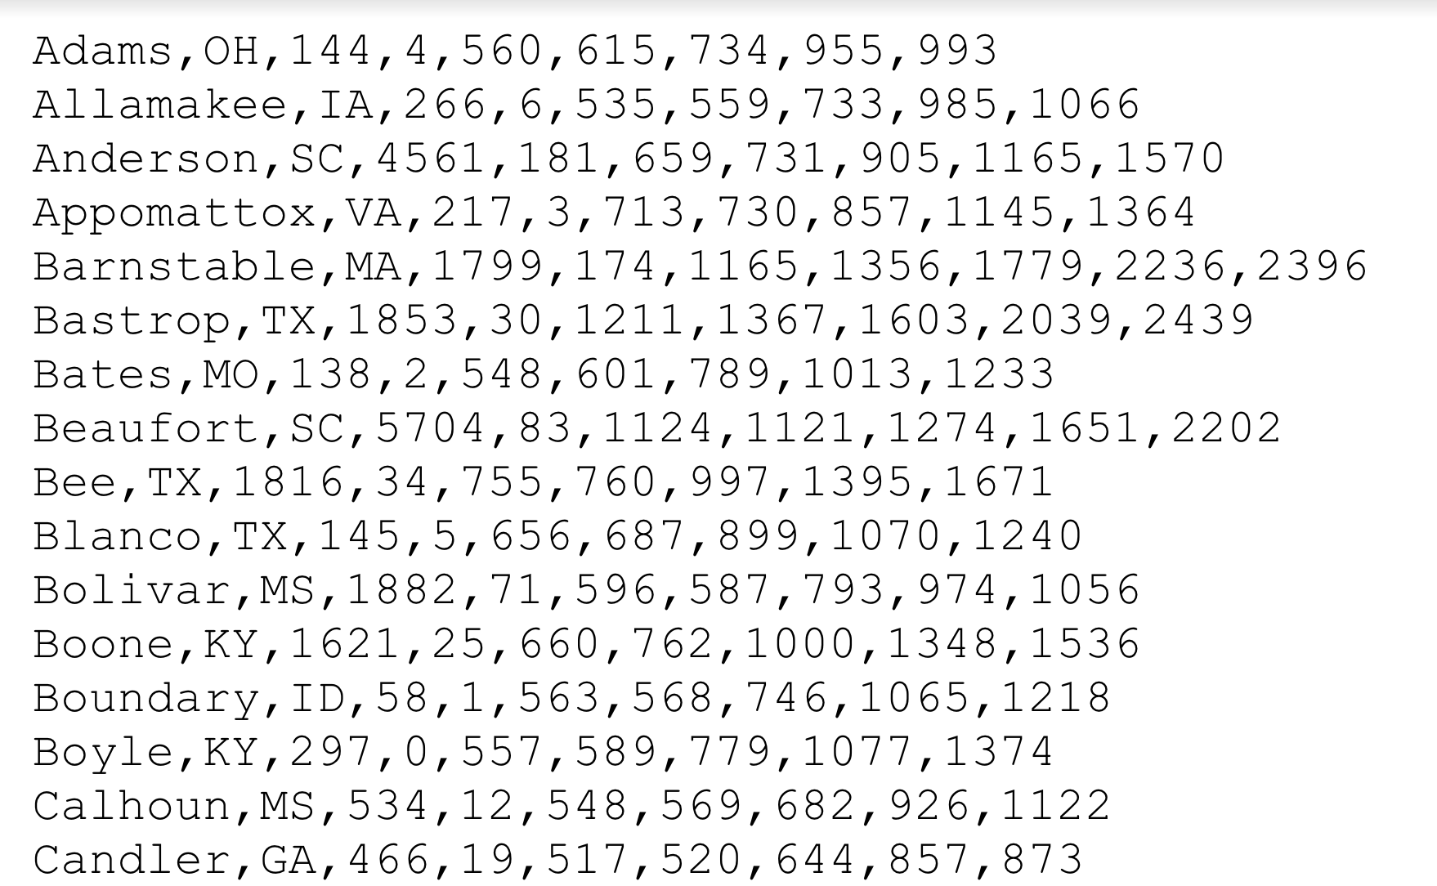
Rental Price Predictions
Least Square Regression Line model
Results:
(5 numbers of each row represent the predicted FMR of 5 types of apartments)

Slide 13
Summary
Covid-19 negatively impacted the rental market.
The rental price prediction of FY 2020
Future Work
Covid-19’s influence to other industries
How do findings help the business?

